Slide 1

Optimal Parameters - Moving average, Threshold, Sliding

Slide 2
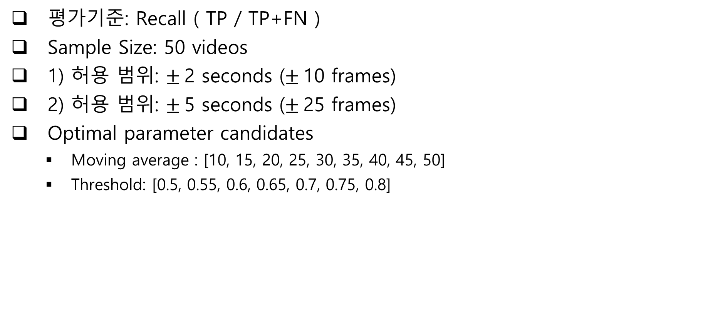
실험 개요
평가기준: Recall ( TP / TP+FN )
Sample Size: 50 videos
1) 허용 범위: $±$2 seconds ($±$10 frames)
2) 허용 범위: $±$5 seconds ($±$25 frames)
Optimal parameter candidates
Moving average : [10, 15, 20, 25, 30, 35, 40, 45, 50]
Threshold: [0.5, 0.55, 0.6, 0.65, 0.7, 0.75, 0.8]

Slide 3
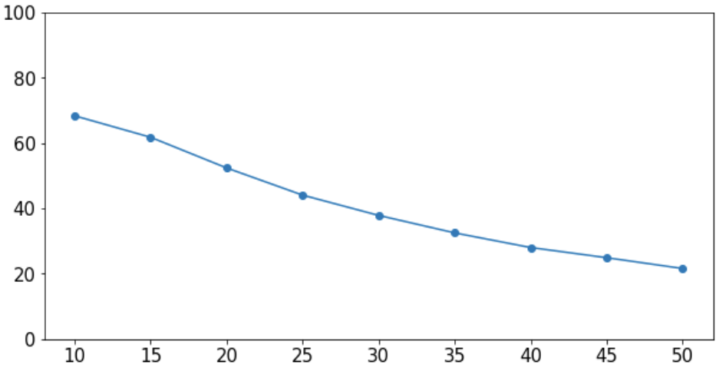
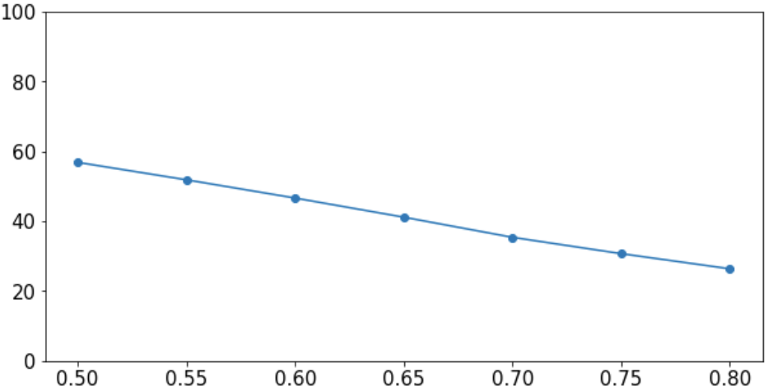
1) 실험 결과 : $±$2 seconds
평균 Recall
Moving Avg. | Threshold | Recall
10 | 0.5 | 79.21
10 | 0.55 | 76.40
15 | 0.5 | 73.59
10 | 0.6 | 72.47
15 | 0.55 | 70.22
10 | 0.65 | 69.10
20 | 0.5 | 67.97
15 | 0.6 | 65.16
10 | 0.7 | 64.60
15 | 0.65 | 62.92
20 | 0.55 | 62.92
10 | 0.75 | 60.67
25 | 0.5 | 60.67
15 | 0.7 | 59.55
20 | 0.6 | 59.55
10 | 0.8 | 56.17
25 | 0.55 | 56.17
30 | 0.5 | 55.61
20 | 0.65 | 55.05
25 | 0.6 | 53.37
Moving Avg.
Threshold

Slide 4
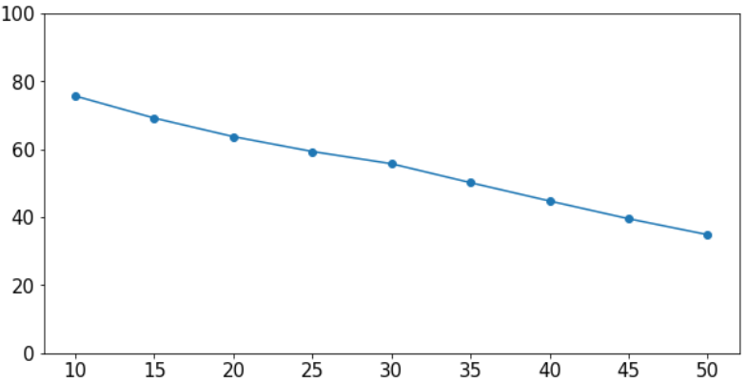
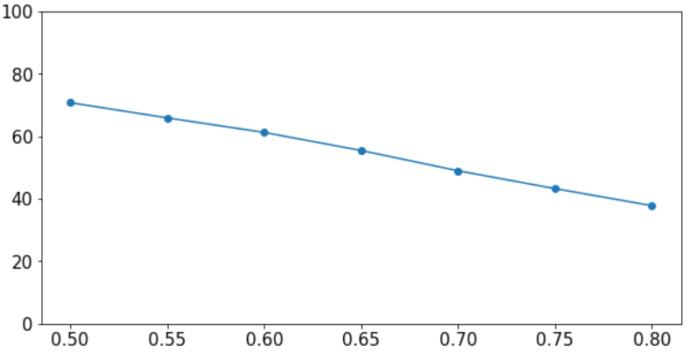
2) 실험 결과 : $±$5 seconds
평균 Recall
Moving Avg. | Threshold | Recall
10 | 0.5 | 86.51
10 | 0.55 | 83.70
10 | 0.6 | 80.89
15 | 0.5 | 80.89
15 | 0.55 | 78.08
10 | 0.65 | 77.52
20 | 0.5 | 76.40
15 | 0.6 | 73.59
25 | 0.5 | 73.03
20 | 0.55 | 71.91
10 | 0.7 | 71.34
30 | 0.5 | 70.78
15 | 0.65 | 69.66
25 | 0.55 | 69.66
20 | 0.6 | 69.10
10 | 0.75 | 67.97
35 | 0.5 | 67.97
30 | 0.55 | 67.41
25 | 0.6 | 66.29
15 | 0.7 | 65.16
Moving Avg.
Threshold

Slide 5
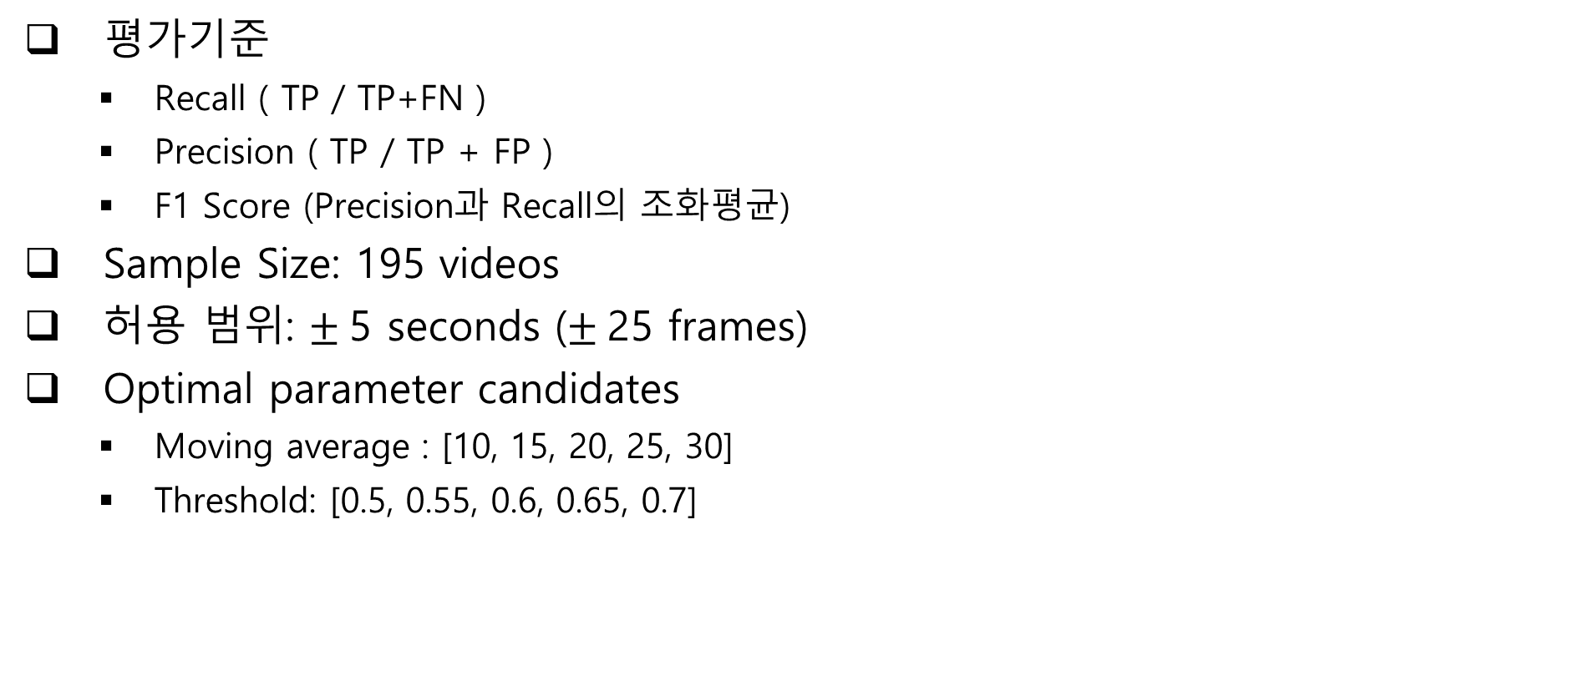
실험 개요
평가기준
Recall ( TP / TP+FN )
Precision ( TP / TP + FP )
F1 Score (Precision과 Recall의 조화평균)
Sample Size: 195 videos
허용 범위: $±$5 seconds ($±$25 frames)
Optimal parameter candidates
Moving average : [10, 15, 20, 25, 30]
Threshold: [0.5, 0.55, 0.6, 0.65, 0.7]

Slide 6
2) 실험 결과 : $±$5 seconds, 195 samples
Moving Avg. | Threshold | Recall | Precision | F1 Score
20 | 0.7 | 55.6567 | 42.81407 | 48.39791
20 | 0.65 | 60.41397 | 37.31225 | 46.13258
15 | 0.7 | 61.43959 | 35.25127 | 44.79893
20 | 0.6 | 65.98203 | 32.93147 | 43.93506
15 | 0.65 | 67.26573 | 31.38643 | 42.80152
20 | 0.55 | 70.3466 | 27.75551 | 39.80558
15 | 0.6 | 71.6303 | 26.95611 | 39.1712
10 | 0.7 | 68.42105 | 27.14071 | 38.86483
10 | 0.65 | 74.5828 | 23.95042 | 36.25761
20 | 0.5 | 73.68421 | 22.99528 | 35.05168
15 | 0.55 | 75.22465 | 22.52457 | 34.66836
10 | 0.6 | 77.5353 | 20.21893 | 32.07392
15 | 0.5 | 78.43389 | 18.74259 | 30.25535
10 | 0.55 | 80.74454 | 17.23871 | 28.41163
10 | 0.5 | 82.54172 | 14.31776 | 24.40263
20 | 0.7 | 55.6567 | 42.81407 | 48.39791
20 | 0.65 | 60.41397 | 37.31225 | 46.13258
15 | 0.7 | 61.43959 | 35.25127 | 44.79893
20 | 0.6 | 65.98203 | 32.93147 | 43.93506
15 | 0.65 | 67.26573 | 31.38643 | 42.80152
Top 1
Top 2
Top 3

Slide 7
Optimal Parameters - Threshold by Class

Slide 8
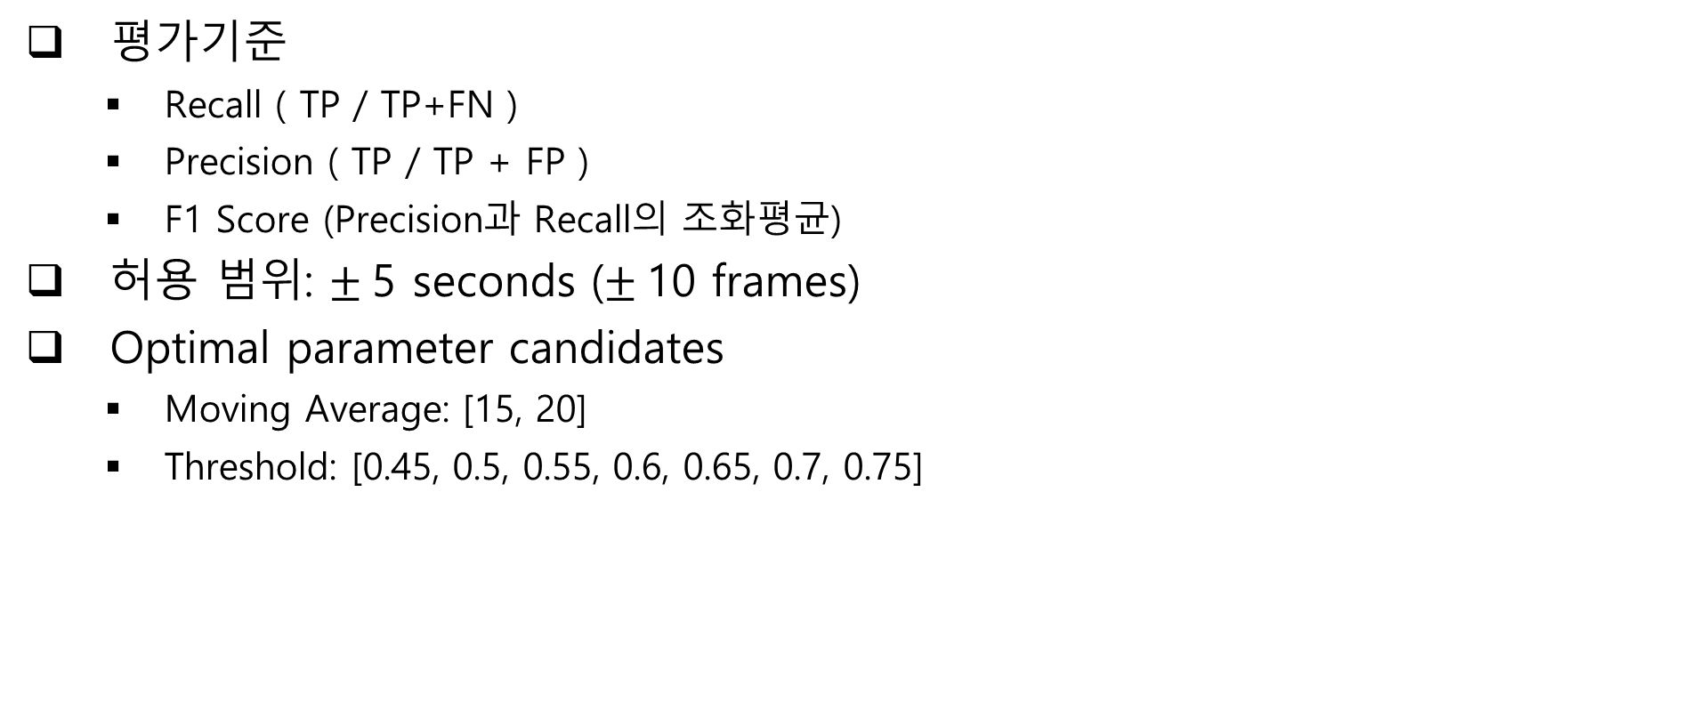
실험 개요
평가기준
Recall ( TP / TP+FN )
Precision ( TP / TP + FP )
F1 Score (Precision과 Recall의 조화평균)
허용 범위: $±$5 seconds ($±$10 frames)
Optimal parameter candidates
Moving Average: [15, 20]
Threshold: [0.45, 0.5, 0.55, 0.6, 0.65, 0.7, 0.75]

Slide 9
Recall
Moving Av. | Threshold | skincare | base | foundation | eyebrow | blusher | eye | shading | highlighter | lip
15 | 0.45 | 76.47059 | 68.51852 | 75.78125 | 87.12871 | 92.70833 | 82.20339 | 89.33333 | 20 | 91.60305
 | 0.5 | 64.70588 | 59.25926 | 71.09375 | 83.16832 | 88.54167 | 81.35593 | 88 | 20 | 90.83969
 | 0.55 | 52.94118 | 48.14815 | 67.96875 | 83.16832 | 83.33333 | 80.50847 | 88 | 16 | 89.31298
 | 0.6 | 47.05882 | 35.18519 | 62.5 | 82.17822 | 82.29167 | 78.81356 | 81.33333 | 8 | 89.31298
 | 0.65 | 35.29412 | 29.62963 | 57.03125 | 82.17822 | 76.04167 | 76.27119 | 72 | 8 | 87.78626
 | 0.7 | 8 | 29.62963 | 52.34375 | 73.26733 | 68.75 | 73.72881 | 68 | 0 | 86.25954
 | 0.75 | 0 | 15.09434 | 44.88189 | 72 | 65.625 | 70.33898 | 64.86486 | 0 | 83.20611
20 | 0.45 | 62.7451 | 51.85185 | 69.53125 | 84.15842 | 87.5 | 80.50847 | 88 | 20 | 90.07634
 | 0.5 | 50.98039 | 48.14815 | 64.0625 | 82.17822 | 81.25 | 79.66102 | 84 | 20 | 89.31298
 | 0.55 | 45.09804 | 40.74074 | 60.9375 | 80.19802 | 79.16667 | 77.11864 | 78.66667 | 12 | 87.78626
 | 0.6 | 35.29412 | 29.62963 | 53.90625 | 79.20792 | 73.95833 | 74.57627 | 74.66667 | 8 | 87.0229
 | 0.65 | 20.40816 | 24.07407 | 49.20635 | 73 | 69.79167 | 69.49153 | 67.56757 | 8 | 82.44275
 | 0.7 | 4.166667 | 15.09434 | 42.06349 | 71 | 67.36842 | 64.40678 | 63.51351 | 0 | 82.30769
 | 0.75 | 0 | 11.32075 | 35.2 | 65.65657 | 61.70213 | 62.39316 | 58.90411 | 0 | 80.76923
25 | 0.45 | 52.94118 | 48.14815 | 61.71875 | 80.19802 | 83.33333 | 77.9661 | 85.33333 | 20 | 89.31298
 | 0.5 | 50.98039 | 44.44444 | 60.9375 | 80.19802 | 79.16667 | 77.11864 | 80 | 16 | 87.78626
 | 0.55 | 37.2549 | 35.18519 | 55.90551 | 78.21782 | 73.95833 | 73.72881 | 77.33333 | 8 | 85.49618
 | 0.6 | 28 | 24.07407 | 48.4127 | 72 | 70.83333 | 68.64407 | 72.97297 | 8 | 82.44275
 | 0.65 | 10.20408 | 20.37037 | 42.06349 | 67.67677 | 66.66667 | 62.39316 | 61.64384 | 4 | 80.15267
 | 0.7 | 4.255319 | 13.20755 | 37.6 | 62.62626 | 60 | 58.11966 | 60.27397 | 0 | 77.69231
 | 0.75 | 0 | 9.615385 | 30.32787 | 60.20408 | 56.98925 | 59.13043 | 50 | 0 | 75.96899
30 | 0.45 | 52.94118 | 42.59259 | 59.375 | 80.19802 | 82.29167 | 77.11864 | 82.66667 | 12 | 87.78626
 | 0.5 | 46 | 40.74074 | 58.26772 | 77 | 77.08333 | 72.0339 | 79.72973 | 8 | 84.73282
 | 0.55 | 30 | 27.77778 | 50.79365 | 73 | 73.95833 | 67.79661 | 68.91892 | 8 | 83.20611
 | 0.6 | 24.4898 | 24.07407 | 44.44444 | 68.68687 | 67.70833 | 63.24786 | 65.75342 | 8 | 79.38931
 | 0.65 | 6.122449 | 12.96296 | 39.51613 | 62.62626 | 63.54167 | 58.11966 | 57.53425 | 0 | 77.09924
 | 0.7 | 0 | 11.53846 | 28.45528 | 59.18367 | 60.6383 | 56.03448 | 51.38889 | 0 | 72.86822
 | 0.75 | 0 | 7.692308 | 27.27273 | 54.08163 | 50.53763 | 53.04348 | 48.61111 | 0 | 70.3125
35 | 0.45 | 58.82353 | 42.59259 | 58.59375 | 73.26733 | 80.20833 | 72.0339 | 78.66667 | 12 | 86.25954
 | 0.5 | 44 | 33.33333 | 51.9685 | 72 | 73.95833 | 69.49153 | 72.97297 | 8 | 83.20611
 | 0.55 | 32.65306 | 27.77778 | 46.03175 | 68 | 69.79167 | 63.55932 | 66.21622 | 8 | 80.15267
 | 0.6 | 20.40816 | 18.51852 | 39.2 | 62.62626 | 64.58333 | 58.11966 | 58.90411 | 4 | 74.80916
 | 0.65 | 8.163265 | 11.32075 | 34.67742 | 58.58586 | 60.41667 | 54.70085 | 53.42466 | 0 | 70.99237
 | 0.7 | 0 | 7.843137 | 28.09917 | 55.10204 | 50 | 53.44828 | 47.22222 | 0 | 69.76744
 | 0.75 | 0 | 5.882353 | 20.16807 | 54.08163 | 42.3913 | 47.36842 | 40.27778 | 0 | 65.625

Slide 10
Precision
Moving Av. | Threshold | skincare | base | foundation | eyebrow | blusher | eye | shading | highlighter | lip
15 | 0.45 | 25.53191 | 46.37681 | 36.02941 | 24.13793 | 20.14388 | 18.88112 | 20.68966 | 21.2766 | 19.2053
 | 0.5 | 30.43478 | 43.93939 | 36 | 22.72727 | 22.96296 | 28.77698 | 18.65672 | 23.48485 | 27.08333
 | 0.55 | 38.63636 | 33.33333 | 44.91525 | 22.76423 | 25.98425 | 31.61765 | 25.38462 | 27.5 | 27.40741
 | 0.6 | 47.61905 | 28 | 46.36364 | 36.97479 | 29.75207 | 33.6 | 31.66667 | 18.18182 | 34.64567
 | 0.65 | 40.54054 | 28.57143 | 50.96154 | 40 | 34.51327 | 43.44262 | 33.63636 | 25 | 38.98305
 | 0.7 | 23.52941 | 55.55556 | 54.08163 | 43.92523 | 32.11009 | 48.67257 | 33.98058 | 34.78261 | 45.53571
 | 0.75 | 0 | 43.75 | 58.13953 | 45.54455 | 42.30769 | 55.66038 | 35.35354 | 32.5 | 43.51852
20 | 0.45 | 33.33333 | 34.375 | 39.68254 | 21.21212 | 24.61538 | 25.53191 | 21.42857 | 20.93023 | 28.96552
 | 0.5 | 37.77778 | 33.33333 | 39.31624 | 26.6129 | 25.78125 | 34.81481 | 27.81955 | 18.10345 | 31.11111
 | 0.55 | 44.18605 | 26.92308 | 43.51852 | 35.83333 | 30.0813 | 40.8 | 25.21008 | 27.02703 | 33.84615
 | 0.6 | 37.83784 | 36.58537 | 48.07692 | 42.47788 | 33.62832 | 43.58974 | 36.11111 | 28.71287 | 40.51724
 | 0.65 | 28.57143 | 40.625 | 47.91667 | 45.63107 | 40.59406 | 53.91304 | 39 | 26.74419 | 46.2963
 | 0.7 | 20 | 47.05882 | 52.94118 | 52.47525 | 47.91667 | 54.28571 | 40.625 | 22.22222 | 55.55556
 | 0.75 | 0 | 50 | 56.33803 | 58.51064 | 47.25275 | 49.50495 | 52.12766 | 24.19355 | 59.78261
25 | 0.45 | 41.86047 | 31.57895 | 36.13445 | 26.19048 | 25.78125 | 33.33333 | 25.38462 | 24.79339 | 27.94118
 | 0.5 | 46.51163 | 28.84615 | 38.39286 | 36.88525 | 30 | 40.90909 | 30 | 24.13793 | 36.71875
 | 0.55 | 35.71429 | 29.78723 | 44.7619 | 45.53571 | 33.94495 | 43.33333 | 33.02752 | 30.69307 | 43.22034
 | 0.6 | 33.33333 | 38.23529 | 51.04167 | 47.16981 | 42.42424 | 52.63158 | 35.57692 | 27.38095 | 40.36697
 | 0.65 | 17.3913 | 44 | 53.48837 | 56.38298 | 50.52632 | 52.33645 | 39.3617 | 31.94444 | 47.87234
 | 0.7 | 28.57143 | 50 | 59.72222 | 57.44681 | 47.12644 | 49.52381 | 50.58824 | 30 | 60.67416
 | 0.75 |  | 62.5 | 60 | 59.77011 | 55.12821 | 54.80769 | 53.33333 | 20.83333 | 66.66667
30 | 0.45 | 44.18605 | 33.33333 | 36.60714 | 35.77236 | 30.57851 | 32.59259 | 30.70866 | 28.81356 | 28.24427
 | 0.5 | 43.90244 | 31.37255 | 41.81818 | 42.01681 | 41.07143 | 38.21138 | 31.30435 | 29.90654 | 37.06897
 | 0.55 | 32.43243 | 32.43243 | 49.49495 | 53.77358 | 41.17647 | 44.91525 | 36.4486 | 35.95506 | 49.0566
 | 0.6 | 32.14286 | 46.66667 | 52.17391 | 56.25 | 45.83333 | 55.45455 | 40 | 32.43243 | 51
 | 0.65 | 13.04348 | 38.88889 | 58.66667 | 55.91398 | 51.68539 | 51.92308 | 49.39759 | 22.95082 | 55.68182
 | 0.7 | 0 | 60 | 58.62069 | 59.77011 | 63.15789 | 49.53271 | 55.40541 | 22.22222 | 67.05882
 | 0.75 |  | 57.14286 | 56.36364 | 60.49383 | 60.86957 | 51.48515 | 53.62319 | 20 | 68.23529
35 | 0.45 | 57.14286 | 29.41176 | 40.17857 | 39.66942 | 33.33333 | 31.25 | 35.83333 | 23.89381 | 36.06557
 | 0.5 | 46.15385 | 27.65957 | 44.23077 | 50 | 38.67925 | 42.37288 | 31.19266 | 28.86598 | 43.92523
 | 0.55 | 37.5 | 37.14286 | 52.08333 | 53 | 43.75 | 48.71795 | 44.89796 | 29.87013 | 52
 | 0.6 | 26.92308 | 44.44444 | 53.65854 | 55.91398 | 55.55556 | 49.07407 | 47.67442 | 25.80645 | 53.84615
 | 0.65 | 15.78947 | 46.66667 | 56.52174 | 59.09091 | 60.25641 | 57.28155 | 42.85714 | 29.78723 | 64.70588
 | 0.7 | 0 | 37.5 | 50.84746 | 61.7284 | 57.14286 | 55 | 47.14286 | 27.77778 | 69.5122
 | 0.75 |  | 50 | 52.17391 | 68.49315 | 55 | 48.95833 | 42.85714 | 23.33333 | 70.88608

Slide 11
F1 Score
Moving Av. | Threshold | skincare | base | foundation | eyebrow | blusher | eye | shading | highlighter | lip | Average
15 | 0.45 | 38.28221 | 55.31418 | 48.83888 | 37.80301 | 33.09649 | 30.7088 | 33.59799 | 20.61856 | 31.75327 | 50.35
 | 0.5 | 41.39785 | 50.46221 | 47.79691 | 35.69911 | 36.46806 | 42.5155 | 30.78645 | 21.60279 | 41.72623
 | 0.55 | 44.67153 | 39.39394 | 54.08798 | 35.74468 | 39.61585 | 45.40402 | 39.40299 | 20.22989 | 41.94361
 | 0.6 | 47.33728 | 31.18406 | 53.23591 | 51.00202 | 43.70342 | 47.11417 | 45.58505 | 11.11111 | 49.92484
 | 0.65 | 37.73585 | 29.09091 | 53.82582 | 53.80875 | 47.4777 | 55.35569 | 45.85198 | 12.12121 | 53.99061
 | 0.7 | 11.9403 | 38.64734 | 53.1985 | 54.92302 | 43.77487 | 58.63611 | 45.31607 | 0 | 59.60594
 | 0.75 |  | 22.44489 | 50.65766 | 55.79515 | 51.44766 | 62.14467 | 45.7641 | 0 | 57.14764
20 | 0.45 | 43.53741 | 41.34228 | 50.52799 | 33.88383 | 38.42196 | 38.76892 | 34.46475 | 20.45455 | 43.83513 | 51.1
 | 0.5 | 43.39715 | 39.39394 | 48.72755 | 40.2055 | 39.14234 | 48.45361 | 41.79666 | 19.00452 | 46.14734
 | 0.55 | 44.63739 | 32.42105 | 50.77562 | 49.53424 | 43.5969 | 53.3663 | 38.18358 | 16.6205 | 48.85585
 | 0.6 | 36.52174 | 32.74216 | 50.82499 | 55.29954 | 46.23426 | 55.02023 | 48.67937 | 12.51348 | 55.29126
 | 0.65 | 23.80952 | 30.23256 | 48.55295 | 56.15844 | 51.3314 | 60.71898 | 49.45473 | 12.31593 | 59.29505
 | 0.7 | 6.896552 | 22.85714 | 46.87961 | 60.34801 | 56.00152 | 58.91473 | 49.55393 | 0 | 66.33602
 | 0.75 |  | 18.46154 | 43.32841 | 61.87797 | 53.51931 | 55.20684 | 55.3091 | 0 | 68.7091
25 | 0.45 | 46.75325 | 38.14181 | 45.58202 | 39.48593 | 39.37947 | 46.70051 | 39.12923 | 22.14022 | 42.56582 | 51.5
 | 0.5 | 48.64359 | 34.98542 | 47.10674 | 50.53026 | 43.51145 | 53.45953 | 43.63636 | 19.24399 | 51.77947
 | 0.55 | 36.46833 | 32.26198 | 49.71692 | 57.56125 | 46.53264 | 54.58494 | 46.28685 | 12.69191 | 57.41569
 | 0.6 | 30.43478 | 29.54545 | 49.69244 | 56.9981 | 53.06577 | 59.58073 | 47.83337 | 12.38223 | 54.19708
 | 0.65 | 12.86174 | 27.8481 | 47.09291 | 61.51581 | 57.48503 | 56.92404 | 48.04502 | 7.109737 | 59.94291
 | 0.7 | 7.407407 | 20.89552 | 46.14682 | 59.92483 | 52.7897 | 53.47852 | 55.008 | 0 | 68.13667
 | 0.75 |  | 16.66667 | 40.29038 | 59.98631 | 56.04328 | 56.88706 | 51.6129 | 0 | 71.01449
30 | 0.45 | 48.16901 | 37.39837 | 45.2907 | 49.47595 | 44.58851 | 45.82022 | 44.78192 | 16.94352 | 42.73805 | 51
 | 0.5 | 44.92675 | 35.44814 | 48.69117 | 54.36701 | 53.58942 | 49.93438 | 44.95714 | 12.62327 | 51.57491
 | 0.55 | 31.16883 | 29.92519 | 50.13589 | 61.92886 | 52.90048 | 54.03339 | 47.68069 | 13.08793 | 61.72275
 | 0.6 | 27.79923 | 31.76265 | 48 | 61.84942 | 54.66361 | 59.09537 | 49.74093 | 12.83422 | 62.10409
 | 0.65 | 8.333333 | 19.44444 | 47.22374 | 59.08008 | 57.00356 | 54.8469 | 53.15635 | 0 | 64.66323
 | 0.7 |  | 19.35484 | 38.31294 | 59.47545 | 61.87246 | 52.58338 | 53.32162 | 0 | 69.84293
 | 0.75 |  | 13.55932 | 36.75889 | 57.1083 | 55.22451 | 52.2527 | 50.99429 | 0 | 69.25833
35 | 0.45 | 57.97101 | 34.79576 | 47.66949 | 51.4708 | 47.0948 | 43.58974 | 49.23823 | 15.97633 | 50.86445 | 50.8
 | 0.5 | 45.05119 | 30.23256 | 47.78845 | 59.01639 | 50.79393 | 52.6451 | 43.70388 | 12.52796 | 57.49719
 | 0.55 | 34.90909 | 31.78484 | 48.87091 | 59.57025 | 53.7844 | 55.15773 | 53.51204 | 12.62003 | 63.07763
 | 0.6 | 23.21725 | 26.14379 | 45.30364 | 59.08008 | 59.73025 | 53.21521 | 52.69765 | 6.926407 | 62.61981
 | 0.65 | 10.76233 | 18.22126 | 42.98347 | 58.8373 | 60.33643 | 55.96147 | 47.56098 | 0 | 67.70351
 | 0.7 |  | 12.97297 | 36.19588 | 58.2273 | 53.33333 | 54.21304 | 47.18251 | 0 | 69.63958
 | 0.75 |  | 10.52632 | 29.09091 | 60.44019 | 47.87946 | 48.15026 | 41.52745 | 0 | 68.15416

Slide 12
결과 분석

Slide 13
Makeup Activity Recognition in Test Videos
Test results
True | CNN-LSTM | Predicted Value | Case Type
Label O | Label O | True Recognition | Case 1
 |  | False Recognition | Case 3
 | Label X | False Recognition | Case 3
Label X | Label O | False Recognition | Case 2
No results |  |  | Case 4
Case 1
Visually good results
Visually NG results
Case 2
Case 3
Case 4
Label X
Recognition O
Label O
Recognition X
Totally wrong results

Slide 14

Moving Average = 15

Slide 15
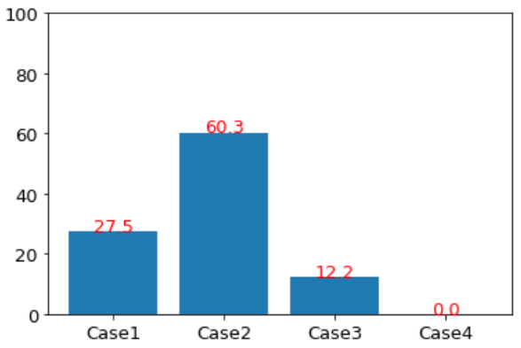
Case별 성능
앞서 실험한 Optimal Parameter (Moving Average, Class 별 Threshold)를 적용하였을 때, Case별 성능은 다음과 같음.
Moving Avg. | Threshold (Average F1 Score = 50.35)
 | skincare | base | foundation | eyebrow | blusher | eye | shading | highlighter | lip
15 | 0.6 | 0.45 | 0.55 | 0.75 | 0.75 | 0.75 | 0.65 | 0.5 | 0.7

Slide 16
Moving Average = 20

Slide 17
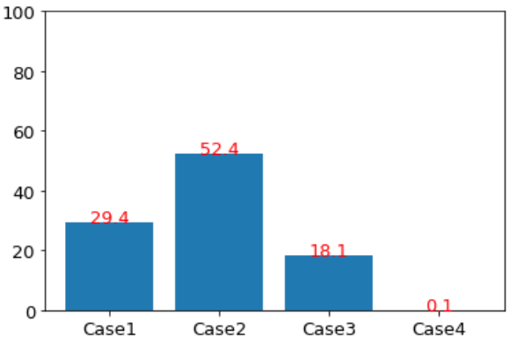
Case별 성능
앞서 실험한 Optimal Parameter (Moving Average, Class 별 Threshold)를 적용하였을 때, Case별 성능은 다음과 같음.
Moving Avg. | Threshold (Average F1 Score = 51.1)
 | skincare | base | foundation | eyebrow | blusher | eye | shading | highlighter | lip
20 | 0.55 | 0.45 | 0.6 | 0.75 | 0.7 | 0.7 | 0.7 | 0.45 | 0.75

Slide 18
Moving Average = 25

Slide 19
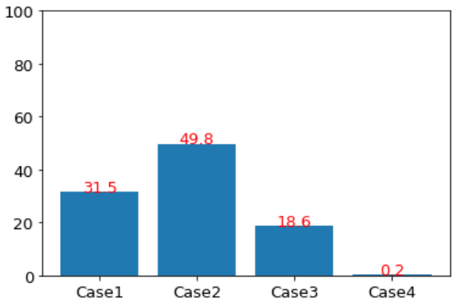
Case별 성능
앞서 실험한 Optimal Parameter (Moving Average, Class 별 Threshold)를 적용하였을 때, Case별 성능은 다음과 같음.
Moving Avg. | Threshold (Average F1 Score = 51.1)
 | skincare | base | foundation | eyebrow | blusher | eye | shading | highlighter | lip
25 | 0.5 | 0.45 | 0.55 | 0.65 | 0.65 | 0.6 | 0.7 | 0.45 | 0.75

Slide 20
Moving Average = 30

Slide 21
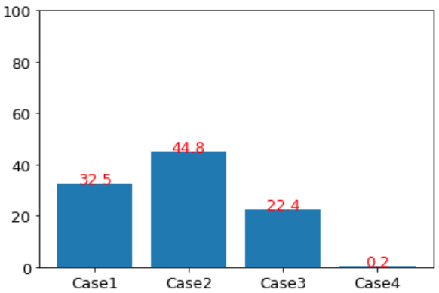
Case별 성능
앞서 실험한 Optimal Parameter (Moving Average, Class 별 Threshold)를 적용하였을 때, Case별 성능은 다음과 같음.
BEST
Moving Avg. | Threshold (Average F1 Score = 51.1)
 | skincare | base | foundation | eyebrow | blusher | eye | shading | highlighter | lip
30 | 0.45 | 0.45 | 0.55 | 0.55 | 0.7 | 0.6 | 0.7 | 0.45 | 0.7

Slide 22
Case 2 분석
1) Label missing
2) Advertising in the beginning part
3) Wrong recognition

Slide 23
Case 3 분석
1) Low probability
2) Confusion among similar makeup activity

Slide 24
Case 4 분석
1) Weird makeup video
2) Non-makeup video

Slide 25
Moving Average = 35

Slide 26
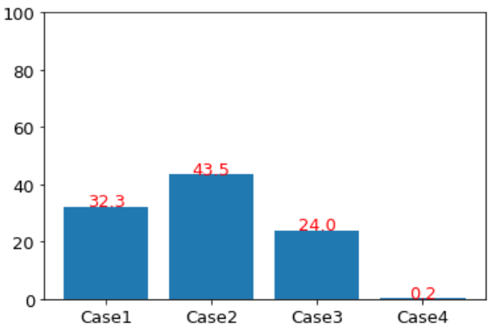
Case별 성능
앞서 실험한 Optimal Parameter (Moving Average, Class 별 Threshold)를 적용하였을 때, Case별 성능은 다음과 같음.
Moving Avg. | Threshold (Average F1 Score = 51.1)
 | skincare | base | foundation | eyebrow | blusher | eye | shading | highlighter | lip
35 | 0.45 | 0.45 | 0.55 | 0.55 | 0.65 | 0.65 | 0.55 | 0.55 | 0.7

